Slide 1
IMAGE PROCESSING WORKSHOP
USING OPEN-CV PYTHON

Slide 2
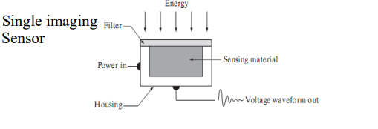
How Is An Image Obtained?

Slide 3
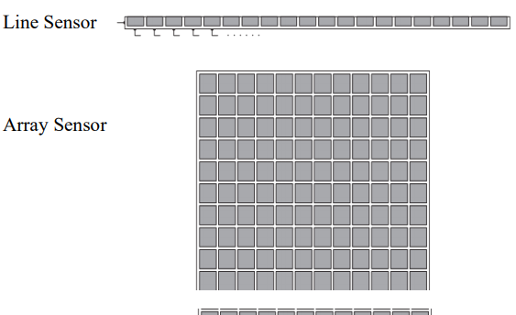
What are the Types Of Sensing Material

Slide 4
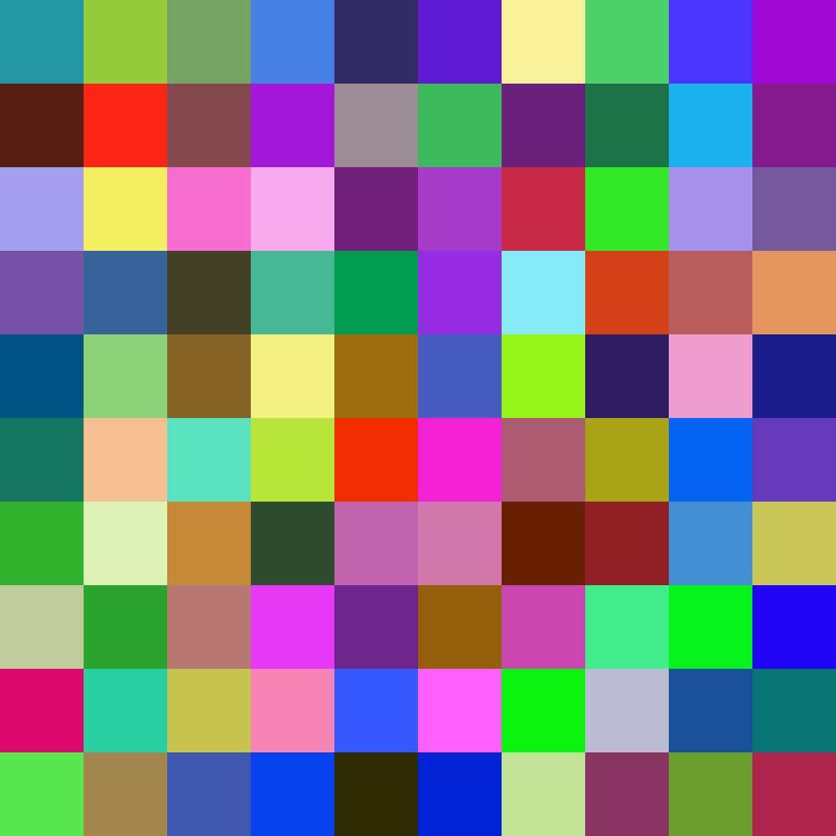
What Is An Image Made Up Of?
An Image is made up of pixels and the Intensity and the colour of the image depends on the value of the pixels.

Slide 5
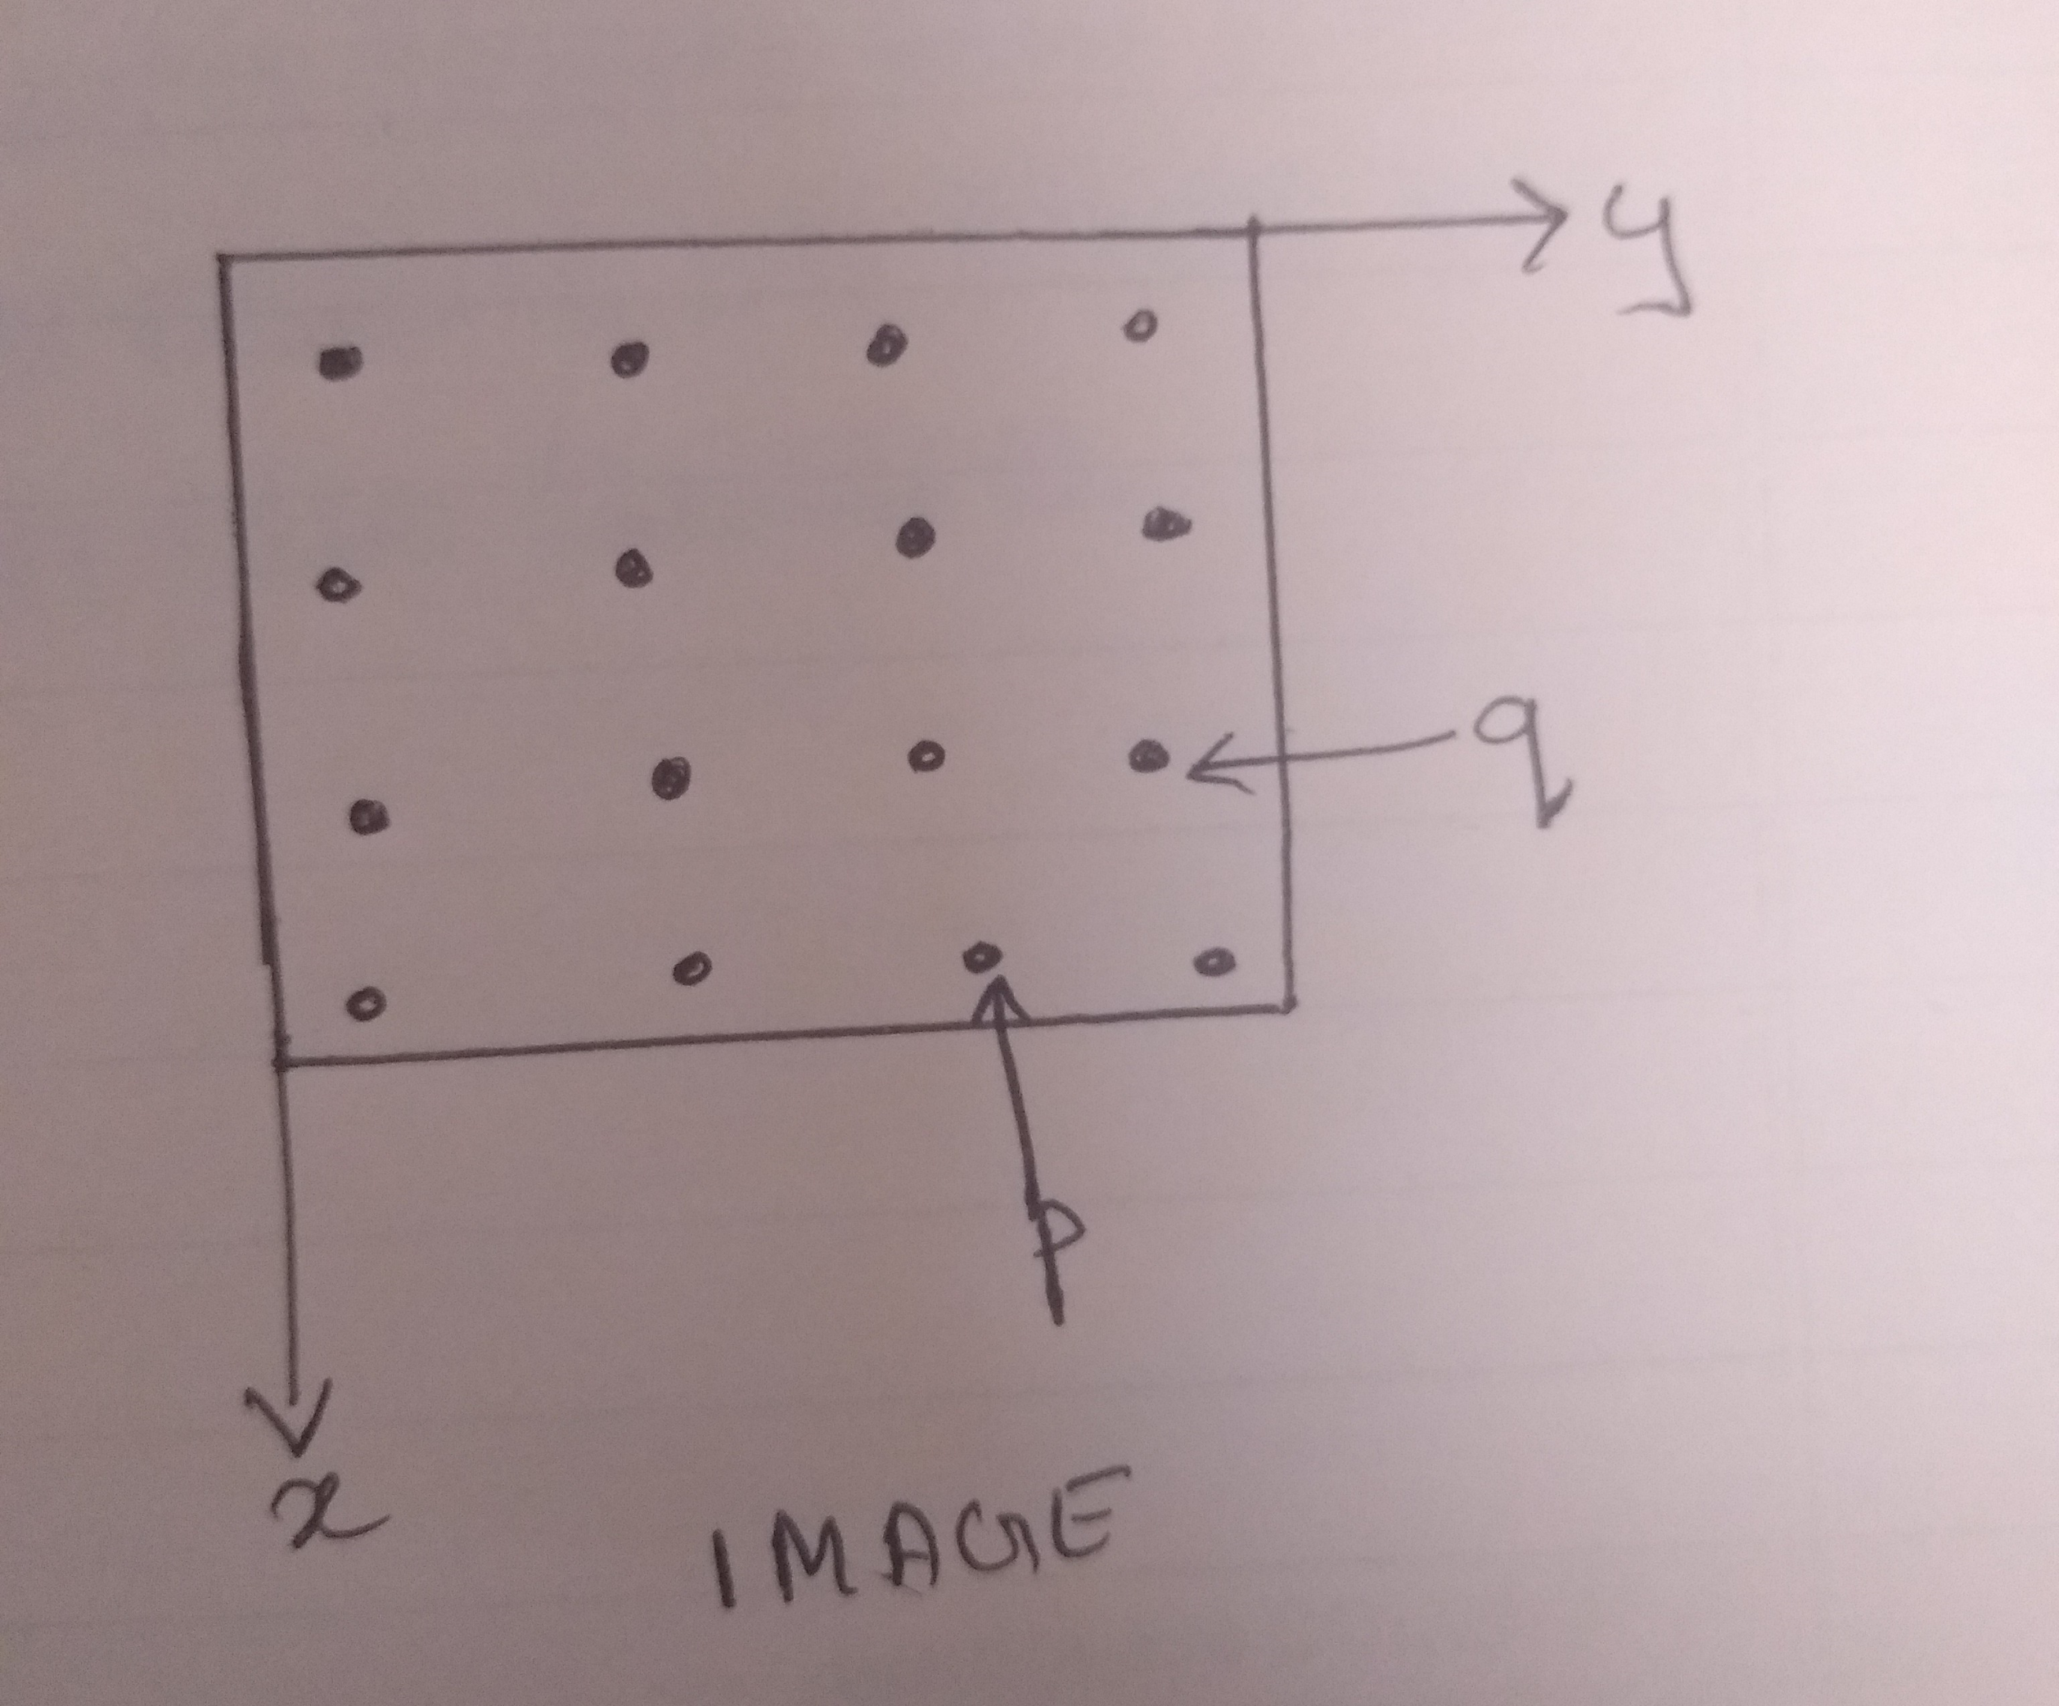
Basic Relationship Between The Pixels
A digital Image can be represented as a two dimensional Function f(y,x)
Where:
y = rows
x = columns
p and q represent the particular pixel
p = f(y,x)

Slide 6
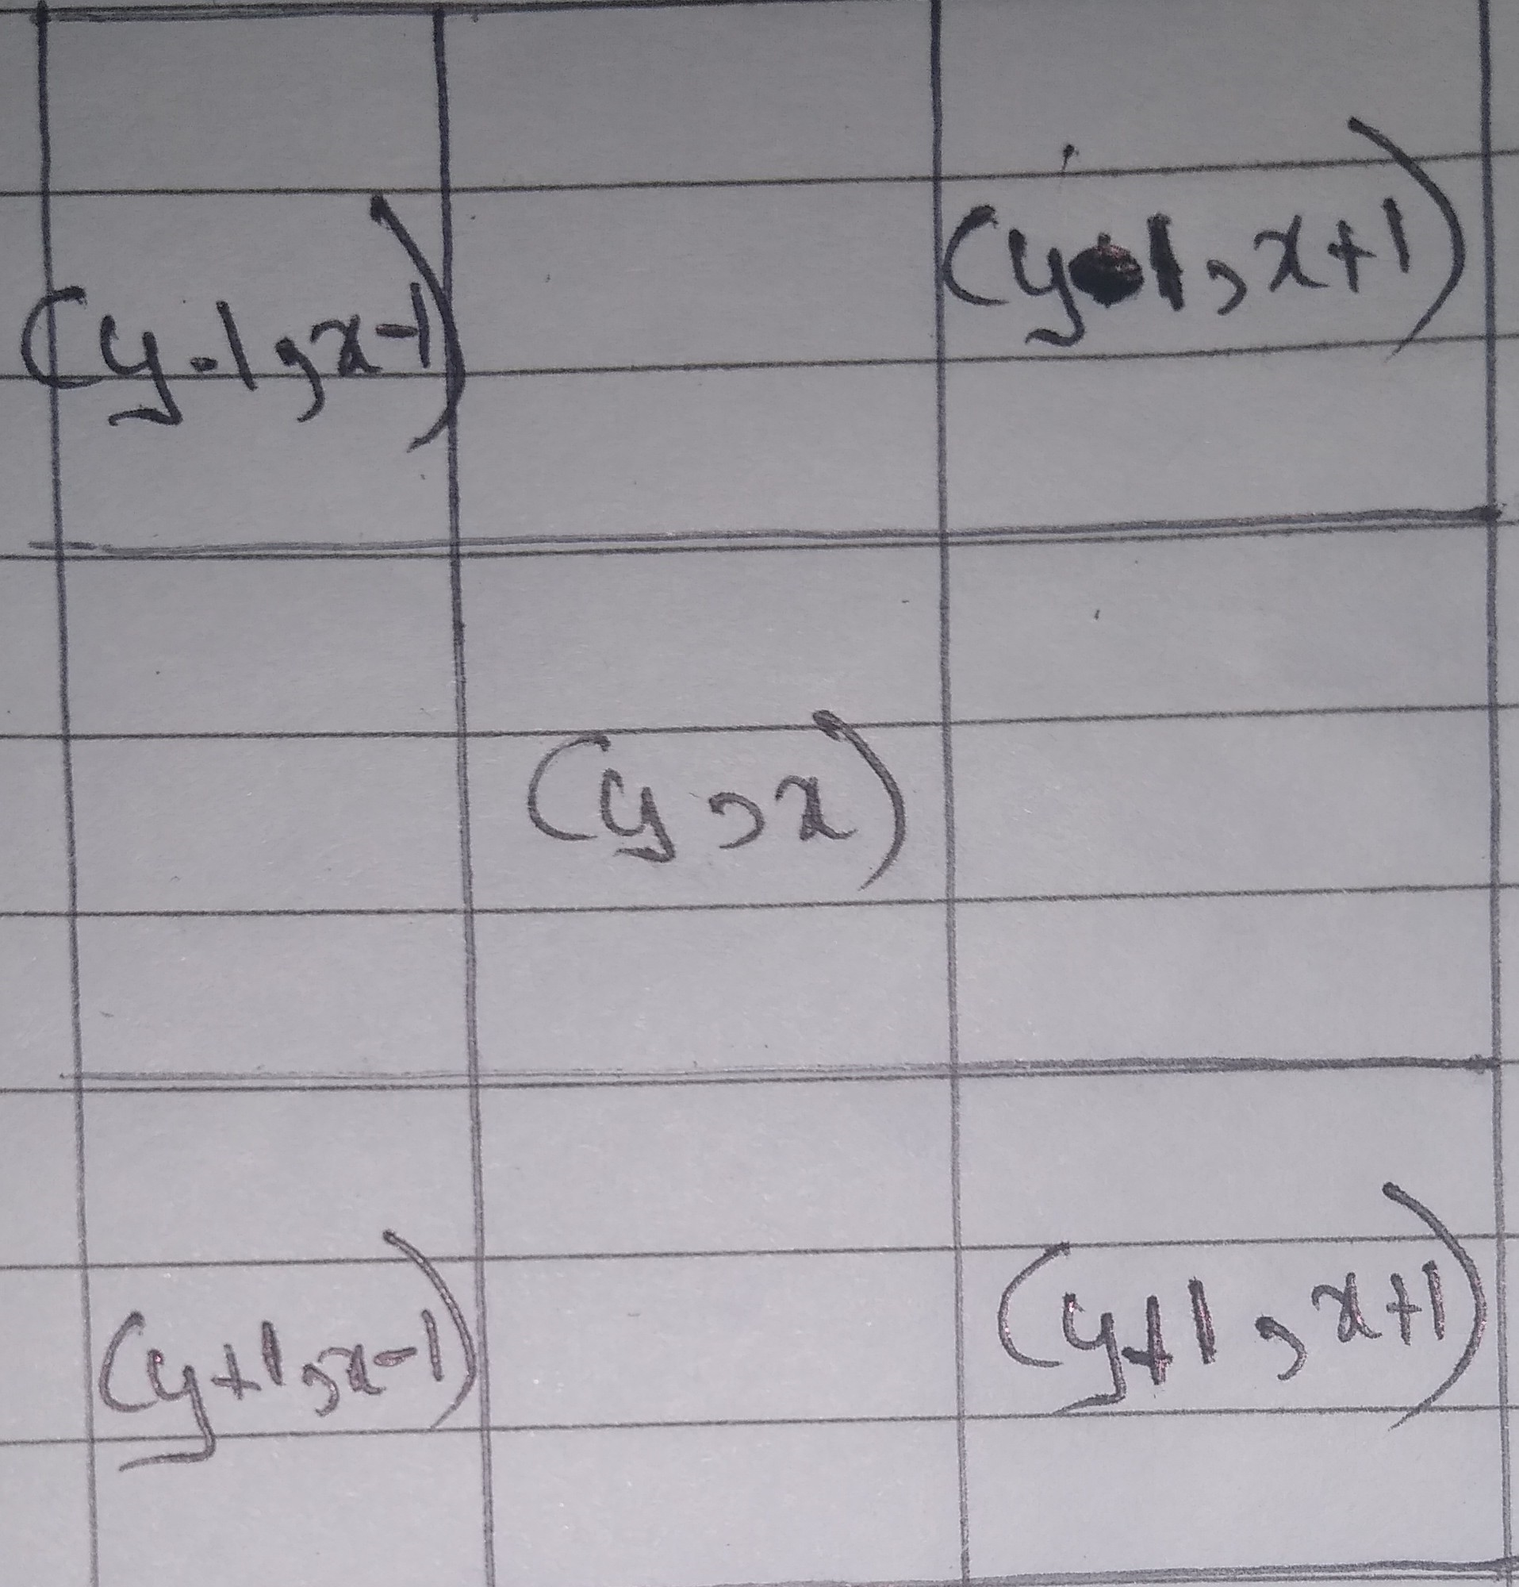
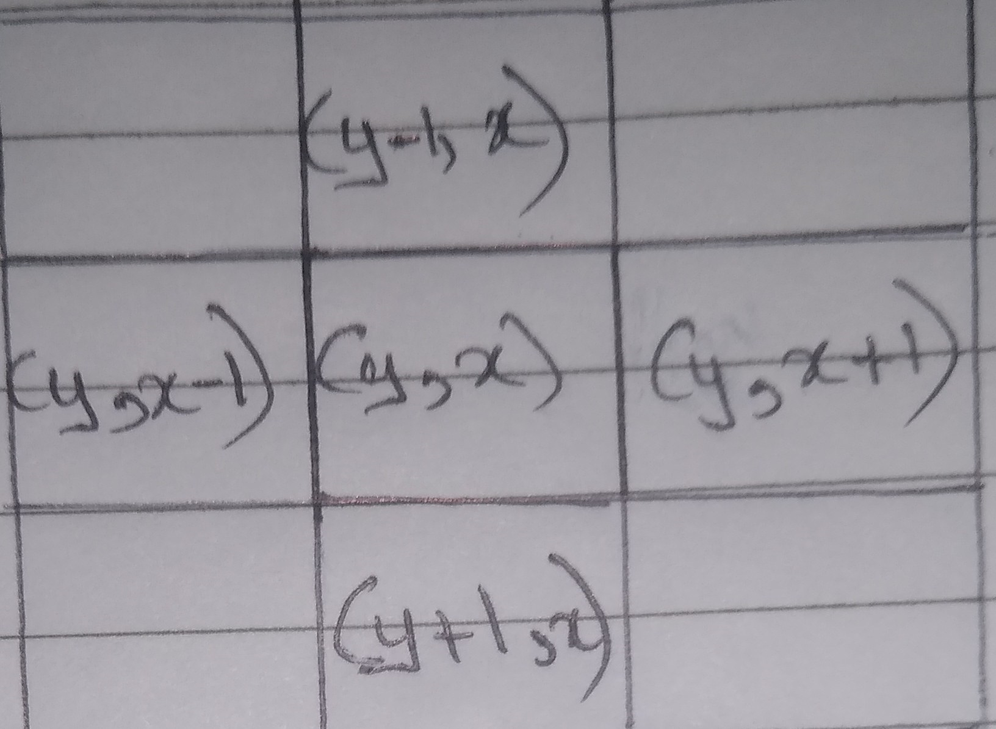
4 Neighbours And Diagonal Neighbours
4 Neighbours[N₄P] Diagonal Neighbours[N_{D}P]

Slide 7
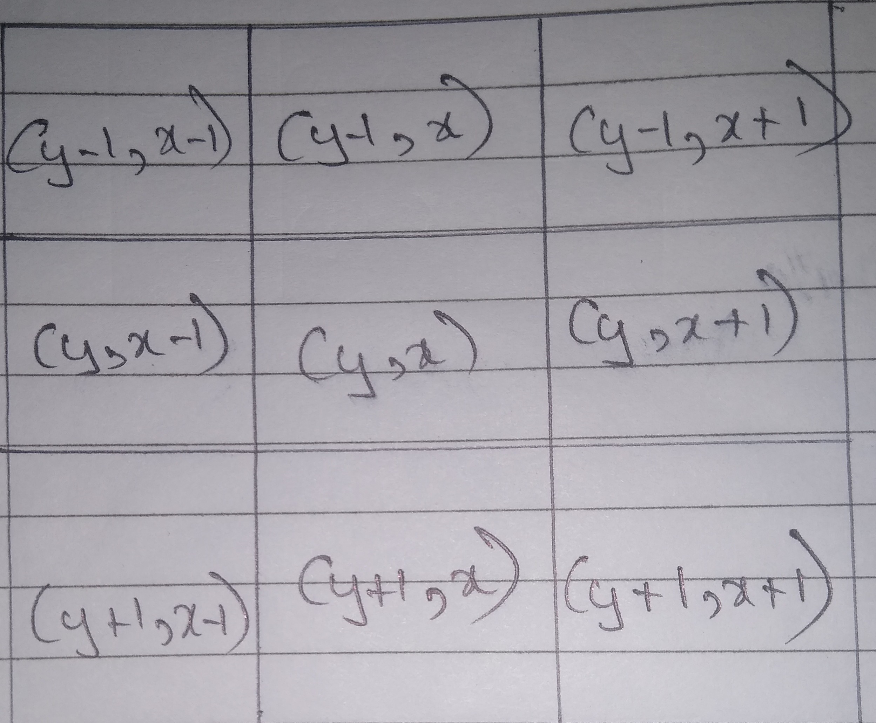
8 Neighbors
This the combination of 4 neighbors and the diagonal neighbors

Slide 8

Types Of Images
Binary Image Example Of a Binary Image
These are Black and White images
The pixel values are either 0 or 1
Where:
0 =dark/black
1 = white/bright

Slide 9
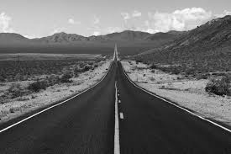
Types Of Images
Example Of a Grayscale Image
Grayscale Image
This image has varying level of brightness and darkness which depends on the value of the pixels
Where:
0 ≤ Pixel Value ≤ 255
Represented in Opencv as cv2.IMREAD_GRAYSCALE or by the value 0.

Slide 10
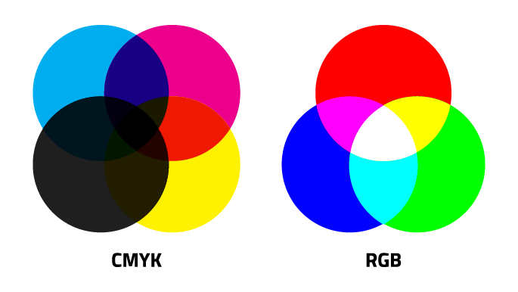
Types Of Images
Coloured images
Red, Blue and Green are the three primary colours
In Open cv it reads an image as BGR
Where:
Blue = (255,0,0)
Green = (0,255,0)
Red = (0,0,255)
On mixing this primary colours we get secondary colours:
Example : yellow = (0, 255,255)
Example:

Slide 11
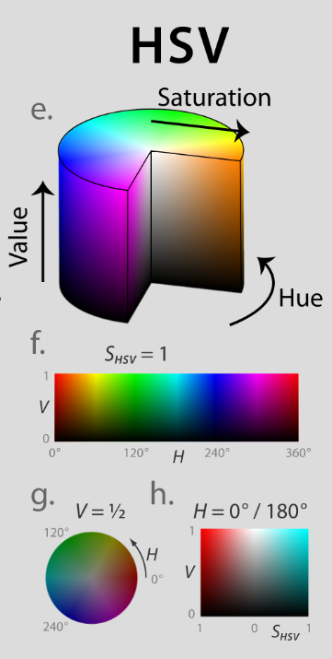
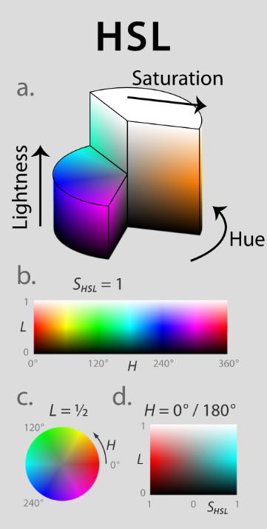
HSV AND HSL
Hue Saturation Value = HSV
Hue Saturation Lightness = HSL

Slide 12
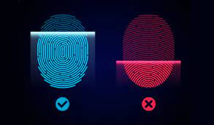
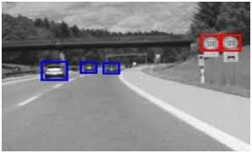
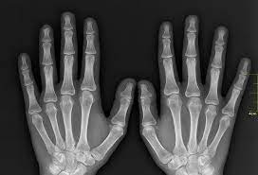
Image Processing And Its Use
Image processing is the method of performing some operations on an image, in order to get an enhanced image or to extract some useful information from it.
USES:
Finger print recognition Hurdle detection X ray

Slide 13
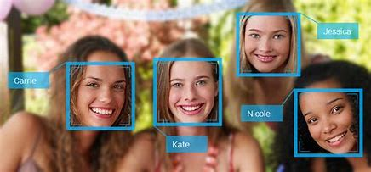
Open-CV Using Python
Open- CV – Open Source Computer Vision
Computer Vision is the way of teaching intelligence to the machines and making them see things and process data just like humans beings.
USE:
Facebook : It detects our faces when we upload an image of us with our friends. This is possible because of FB's face and image recognition technology
To know more about open-cv:
https://opencv.org/about/

Slide 14
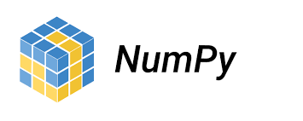
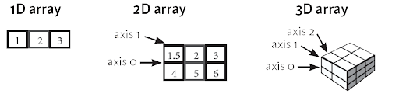
NumPy Library and Its Use
It’s a highly optimized Library for performing numerical operations
It’s an Array Processing Package Library
It showcases High Performance
To know more about the NumPy Library:
https://www.w3schools.com/python/numpy_intro.asp

Slide 15

Matplotlib Library And Its Use
2D plotting library which is used with Open-CV images
It is used with Open-CV to display graphs, images etc.
To Know more about Matplotlib:
https://matplotlib.org/stable/tutorials/introductory/usage.html

Slide 16
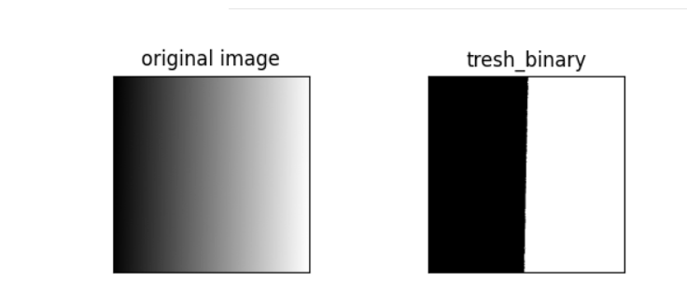
Simple Thresholding
It is an image segmentation technique use to separate an object from the background.
Simple thresholding operation is performed by comparing every pixel value of the image with the threshold value.
To know more about simple thresholding:
https://www.tutorialspoint.com/opencv/opencv_simple_threshold.htm

Slide 17
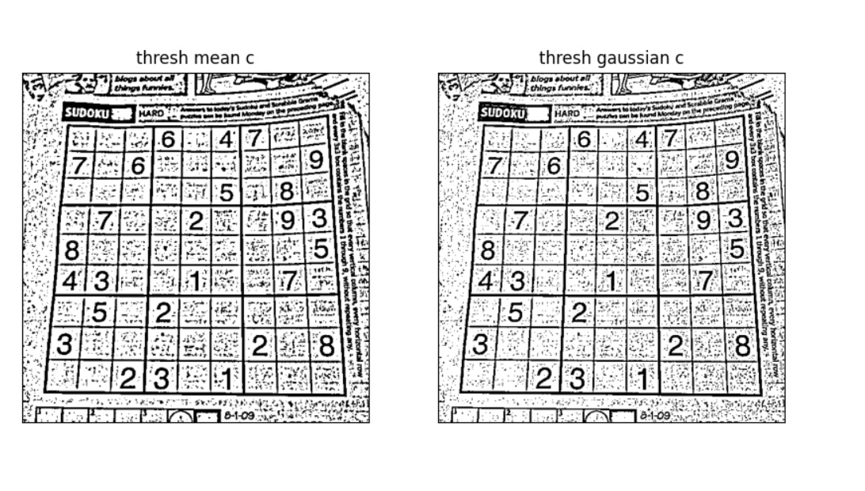
Adaptive Thresholding
This is a method in which the threshold value is calculated for the smaller region of the image. Therefore there will be different threshold values for different regions of the same image.
This method is useful for the images having different lighting conditions.
To know more about adaptive thresholding:
https://homepages.inf.ed.ac.uk/rbf/HIPR2/adpthrsh.htm

Slide 18
THANK YOU!

